Slide 1
Design and Methodology, Algorithms, Dataflow Diagram
ABHIN
II MCA

Slide 2
DESIGN AND METHODOLOGY
Full-stack platform powered by ML/DL
• Diseases: Diabetes
• Frontend: Flask + HTML/CSS (Login, forms, signup)
• Backend: Flask + MySQL + REST APIs

Slide 3
Algorithms
Logistic Regression – binary classification (diabetes)
Random Forest – ensemble method for tabular data(diabetes)
Support Vector Machine (SVM) – classification
Multi-Layer Perceptron (MLP) – deep learning for health inputs

Slide 4
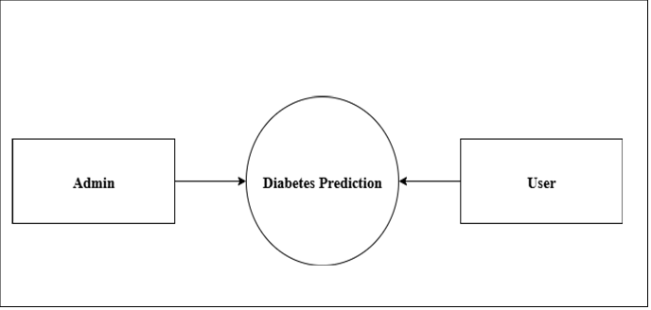
Data Flow Diagram
DFD Level 0

Slide 5
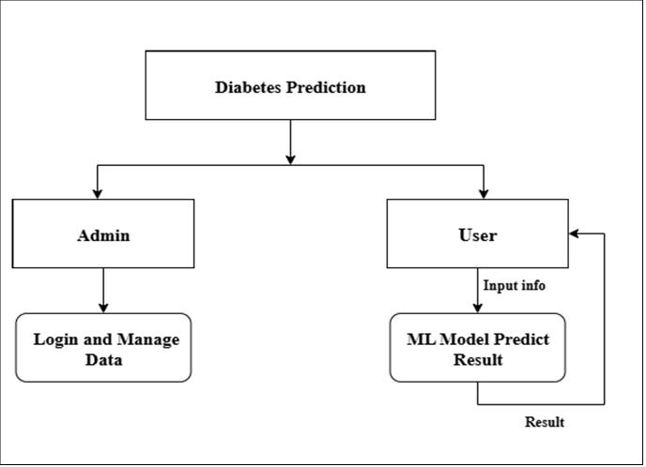
DFD Level 1

Slide 6
Relevant Techniques
• Data preprocessing: scaling, encoding
• Model training: ML + DL, cross-validation
• Security: password hashing, session handling
• Report: PDF generation + email
• Database: MySQL for storing records

